Slide 1
Weight Distribution Before and After Training GPT-2
Hi, I’m GPT 2
(AI)

Slide 2
Group Members:
Asfaria Islam Chowdhury – 1931741642
Md. Rifat Ahmed – 1931725042
Mohammed Rakibul Hasan – 1921798042
Md. Nurer Safa Fahim – 1931096042

Slide 3
Discussion
We wanted to do a Project related with Text generation but since that was not related with our Course Topic we changed our Project according to the faculty's instruction

Slide 4
Objectives
Get the PT file
Draw weight distributions from Heads H5 to H11 for Layer L1 and L2; and from Final Layer FL before training the GPT-2 model
Repeat the same for a trained GPT-2 model
Compare the Histograms

Slide 5
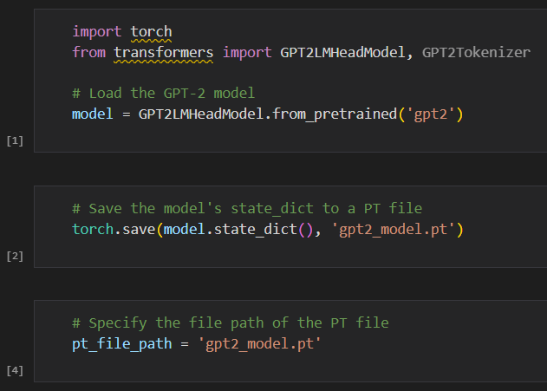
Getting the PT file

Slide 6
Weight Histograms (Key Details)
We’ve Frozen the first 6 heads (H0 – H5)
Kept H6 to H11 & the Final Layer Unfrozen (during the Training)
The work was done for Layer 1 & 2

Slide 7
Comparing the Weights Histograms, looking at H5 & H6 to understand overall layer trends
NB: H5 to H11 & FL pictures are in Colab file

Slide 8
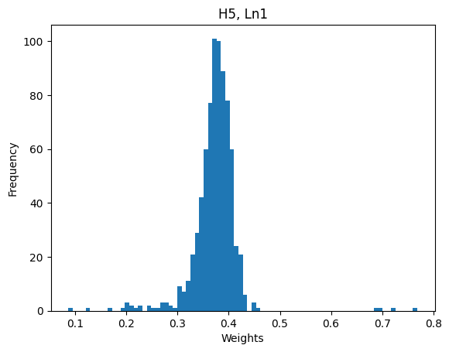
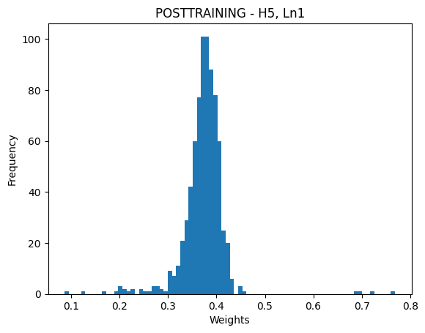
FROZEN HEAD, H5 – L1
PRE-TRAINING -

Slide 9
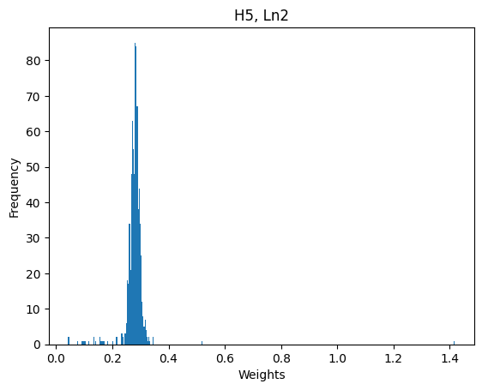
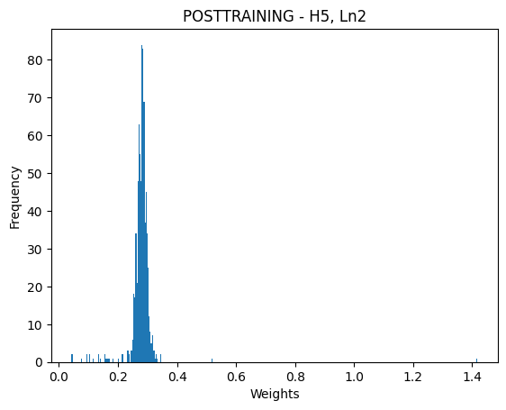
FROZEN HEAD, H5 – L2
PRE-TRAINING -

Slide 10
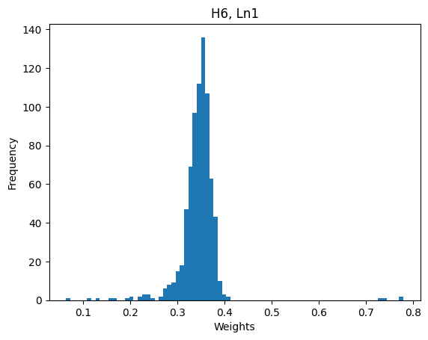

UNFROZEN, H6 – L1
PRE-TRAINING -

Slide 11
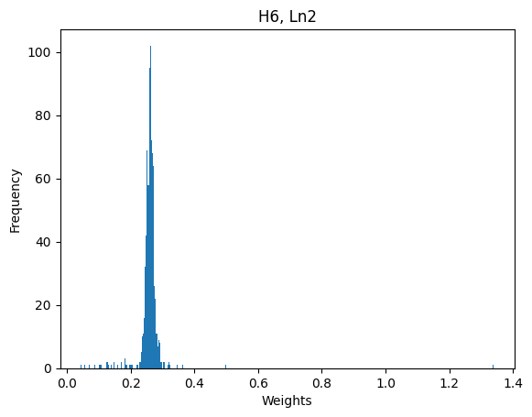
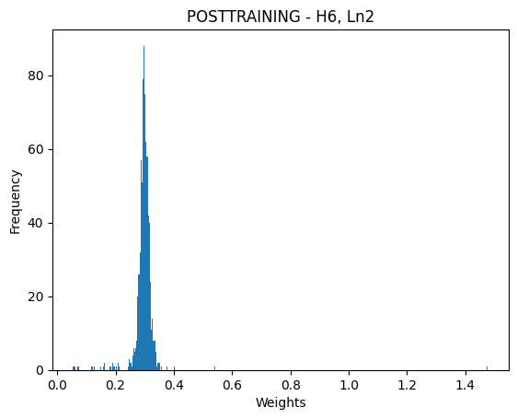
UNFROZEN, H6 – L2
PRE-TRAINING -

Slide 12
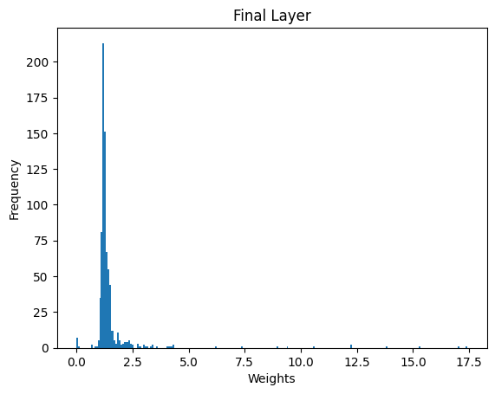
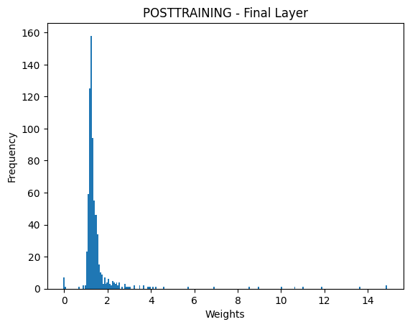
Final Layer (UNFROZEN)
PRE-TRAINING -

Slide 13
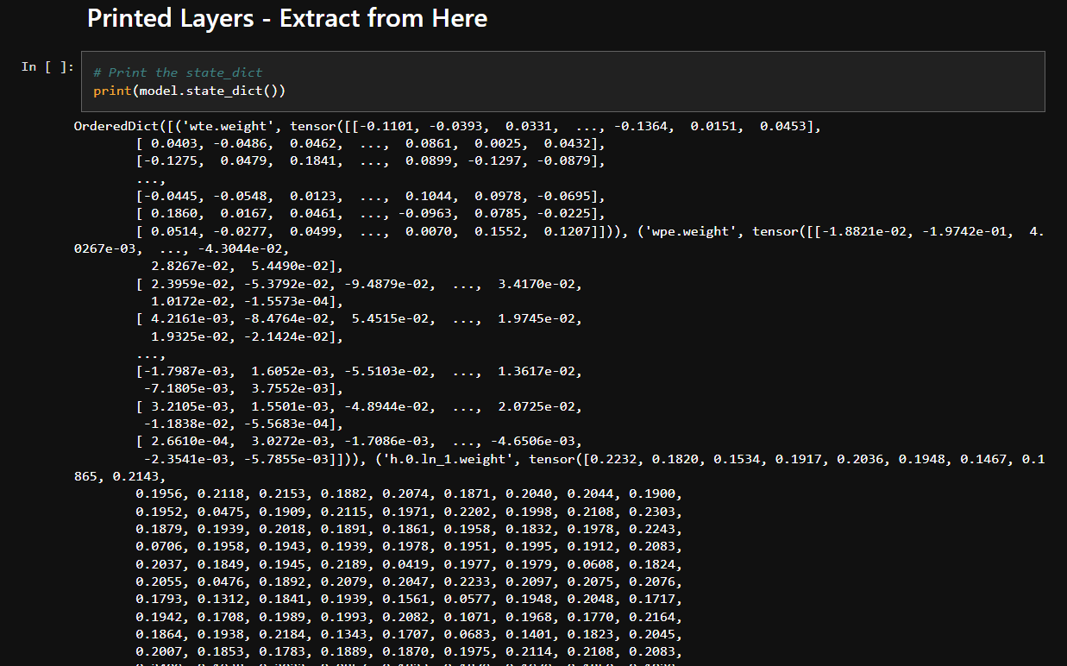

Slide 14
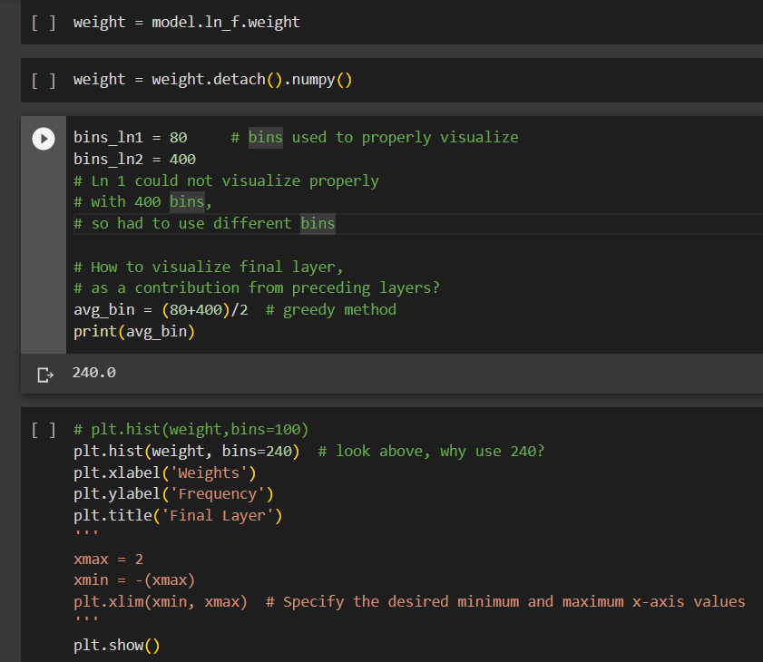

Slide 15
Why is Understanding Weight Distribution in GPT 2 Important?
Model Initialization and Training -
Check if weights are initialized properly
Check if there are any biases or imbalances in initial weights
Weight Scaling and Normalization -
Layer normalization is used to standardize hidden state.
Is there any outlier or not?
Convergence -
In L2’s, weights are more converged than L1’s.
The pre-trained and post-trained FL’s

Slide 16
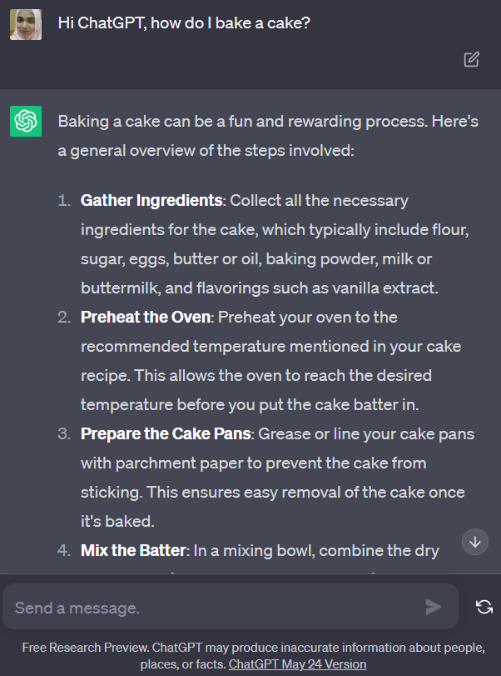
Thank You!
All Histrograms available here: https://github.com/AsfariaChowdhury/CSE465_GPT2_WeightDistribution
Hello humans. Please train me as a good language model.

